Slide 1
CENTRE for INDUSTRY
EDUCATION COLLABORATION
Sustainable ingredients:
Monitoring microbes

Slide 2
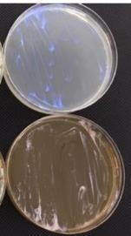
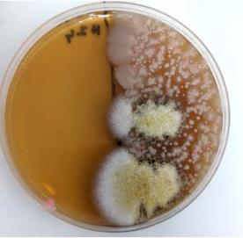
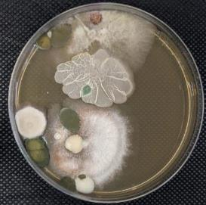
Scientists carry out tests using agar plates which reveal any bacteria in their products and show if their products are infected by bacteria.
agar plates with no infection
agar plates showing infection
Notes:
Images 1-3: provided by Synthomer - JPGs requested

Slide 3
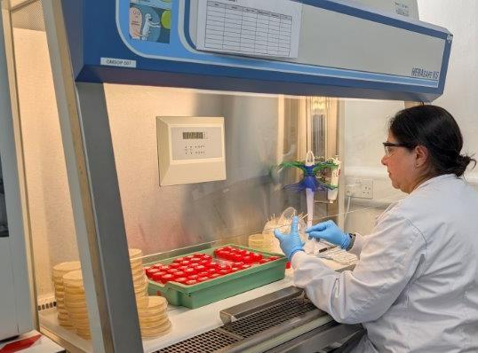
Scientists use regular testing to keep their ingredients free from infection caused by bacteria.
Notes:
Image: provided by Synthomer - JPG requested

Slide 4
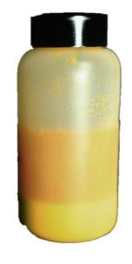
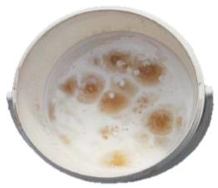
Regular testing means ingredients are made that cause less harm to the environment.
infected products
visible microbe growth
ingredients separating
Notes:
Images: provided by Synthomer - JPGs requested

Slide 5
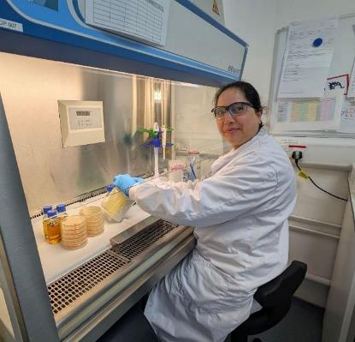
STEM Careers
This is Vaishali
She studied microbiology at university and has worked at many companies which make medicines.
She works with very tiny living things which cannot be seen with the naked eye, so she uses a microscope to observe them.
At Synthomer, Vaishali makes sure that the paints, glue, and gloves are infection free and safe to use. She helps to make the world a better and safer place by reducing the use of harmful ingredients in their products.
Notes:
Image: JPG provided by Synthomer

Slide 6

www.ciec.org.uk

